Slide 1
Nose Cone &
Fin Optimization
Tripoli Minnesota
Gary Stroick
January 2011

Slide 2
Purpose
Focus is on drag optimization to maximize rocket performance!
Copyright © 2011 by Off We Go Rocketry

Slide 3
Agenda
Definitions
Mission Parameters
Nose Cone Design
Fin Design
Summary
Appendices
References & Web Sites
Copyright © 2011 by Off We Go Rocketry
Notes:
Copyright © 2010 by Gary Stroick

Slide 4
Definitions¹
Drag Coefficient
  Parasitic Drag
    Form/Pressure/Profile Drag
      Dependence upon the profile of the object
      Base Drag
        Due to Boundary Layer separation at base of airframe/fins
    Skin Friction (Viscous) Drag
      Friction of the fluid against the skin of the object
    Interference Drag
      Incremental drag above sum of all other drag components. Created at protrusion intersections.
  Induced (Lift-Induced) Drag
    Due to redirection of airflow
  Wave (Compressibility) Drag
    Due to shockwaves when moving near or above the speed of sound (typically leading & trailing edges)
  Rotational Drag
    Circumferential velocity from roll will thicken boundary layer and result in increased drag
Copyright © 2011 by Off We Go Rocketry

Slide 5
Definitions¹
Wetted Area
  Surface Area exposed to airflow
Fineness (Aspect) Ratio
  Nose Cone Length/Base Diameter
Bluffness Ratio
  Tip Diameter/Base Diameter
  Hemispherical Blunting
  Me’plat Diameter is a Flat Truncation (e.g., bullets and artillery shells)
Copyright © 2011 by Off We Go Rocketry

Slide 6
Definitions¹
Laminar Boundary Layer
  Fluid streams move in parallel (negligible transfer of momentum)
Turbulent Boundary Layer
  Fluid streams transverse with velocity variations around an average value
Boundary Layer Separation
  Boundary layer separates from object’s surface creating an effective profile
Reynolds Number
  Dimensionless ratio of inertial / viscous forces
  http://www.grc.nasa.gov/WWW/BGH/reynolds.html
Copyright © 2011 by Off We Go Rocketry

Slide 7
Definitions¹
Aspect Ratio (AR)
  Fin Span / Average Fin Cord
Effective Aspect Ratio
  Working AR due to Airflow Effects
Taper Ratio
  Tip Cord / Root Cord
Copyright © 2011 by Off We Go Rocketry

Slide 8
Definitions
Thrust Profile
  Thrust vs. Time Curve
Velocity Definitions
  Subsonic: < .8 Mach
  Transonic: .8 to 1.2 Mach
  Supersonic: 1.2 to 5 Mach
  Hypersonic: > 5 Mach
Copyright © 2011 by Off We Go Rocketry
Notes:
Copyright © 2010 by Gary Stroick

Slide 9
Mission Parameters
Velocity
  Coefficient of Drag
  Thrust Profile
  Total Mass
Altitude
  Coefficient of Drag
  Thrust Profile
  Total and Coasting Mass
Mass
  Material Volume and Strength
  Payload
Payload
  Available Volume
  Stability Impacts
Stability (CP&CG - Discussed Last Year)
Copyright © 2011 by Off We Go Rocketry
Notes:
Copyright © 2010 by Gary Stroick

Slide 10
Nose Cone Design
Mission Dependent Variables
  Payload
  Stability (CP, CG)
Independent Variables
  Atmospheric Density
  Temperature
  Wind Conditions
  Surface Finish
  Angle of Attack
Copyright © 2011 by Off We Go Rocketry

Slide 11
Nose Cone Design
Assumptions
  Zero Angle of Attack
  Constant Surface Finish
  No Roll
  No Aerodynamic Heating Effects
Copyright © 2011 by Off We Go Rocketry

Slide 12
Nose Cone Solutions
Best in Class
Subsonic¹
Elliptical
Transonic⁴
LD-Haack (Von Karman)
X^{½} Power Series
LV-Haack (< Mach 1)
Supersonic⁷
Eggers Minimum Drag
X^{¾} Power Series
Hypersonic^{8,9,10}
Love Minimum Drag
X^{.6} Power Series
Copyright © 2011 by Off We Go Rocketry

Slide 13
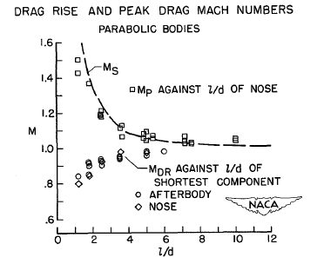
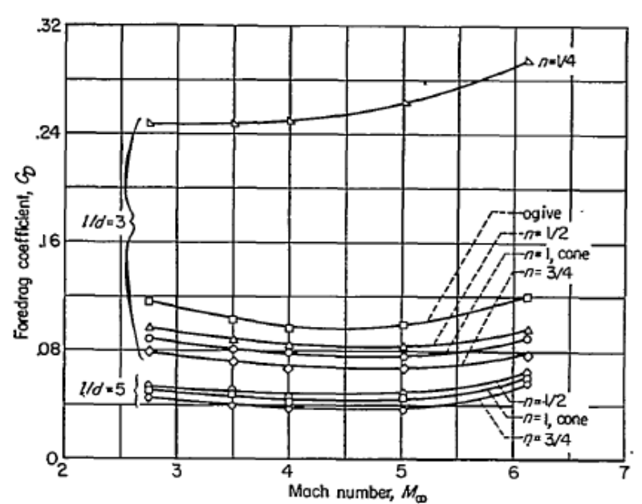
Fineness Ratio^{6,7}
Increasing Fineness Ratio
  Decreases Wave Drag
  Increases Skin Friction Drag
  Optimum Ratio is approximately 5
Copyright © 2011 by Off We Go Rocketry

Slide 14
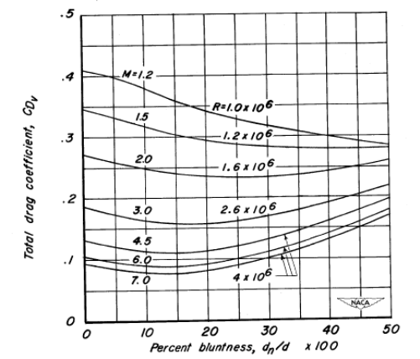
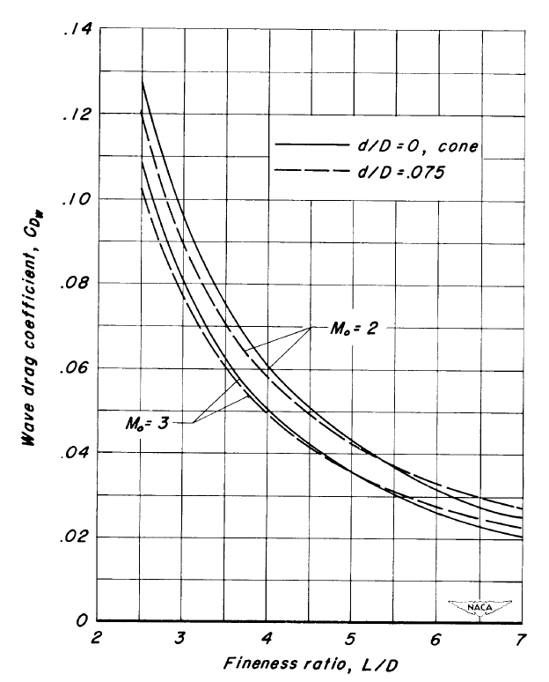
Bluntness Ratio^{2,3,5}
Optimal ratio is .15
  Provided length remains constant
Applicability dependent upon fineness ratio and velocity
  Fineness ratio ≤ 5
  Below Hypersonic
Copyright © 2011 by Off We Go Rocketry

Slide 15
Coefficient of Drag (C_{D})
Subsonic¹
Primarily Skin Friction Drag
Minimal Pressure Drag
No Wave Drag
No Interference Drag
No Induced Drag
Elliptical
  Fineness Ratio of 2
Copyright © 2011 by Off We Go Rocketry

Slide 16
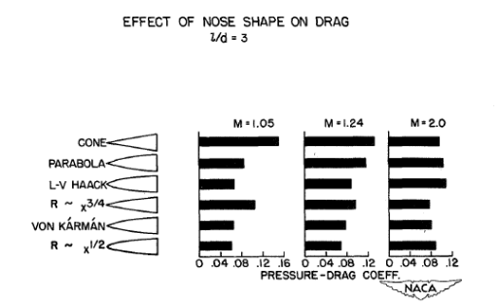
Coefficient of Drag (C_{D})
Transonic⁴
Tangent Ogive
4
Conical
4
LV-HAACK
1
3
Von Karman (LD-HAACK)
1
2
1
3
2
1
Parabola
1
3
3/4 Parabola
3
2
1
2
1/2 Parabola
3
2
x^{3/4} Power
2
3
2
x^{1/2} Power
1
2
1
2
1
2
3
0.8
1.0
1.2
1.4
1.6
1.8
2.0
MACH NUMBER
Comparison of drag characteristics of various nose shapes in the transonic-to-
low Mach regions. Rankings are: superior (1), good (2), fair (3), inferior (4).
Wave Drag Increases Substantially
Pressure Drag becomes Significant
Fineness Ratio of 5 is Critical
Copyright © 2011 by Off We Go Rocketry

Slide 17
Coefficient of Drag (C_{D})
Supersonic⁷
Pressure Drag Decreases
Wave Drag Decreases
Fineness Ratio of 5 is Critical
Copyright © 2011 by Off We Go Rocketry

Slide 18
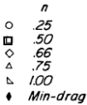
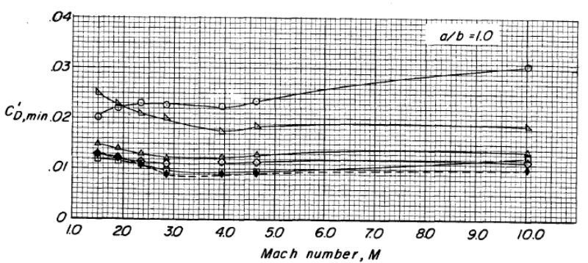
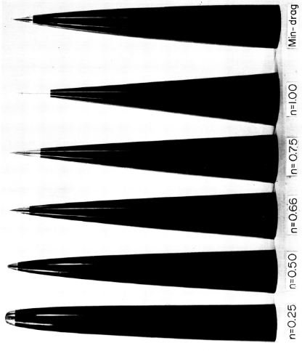
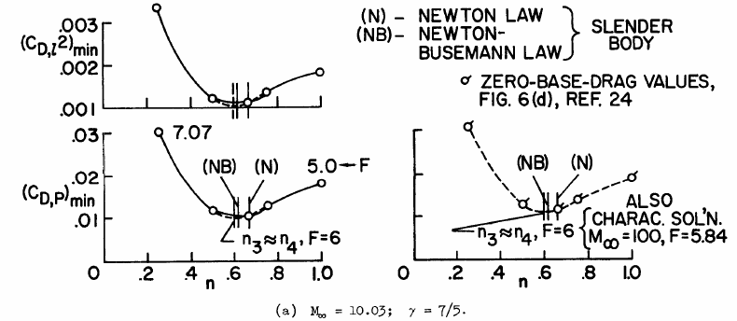
Coefficient of Drag (C_{D})
Hypersonic^{8,9,10}
X^{.6} Power Series
  Fineness Ratio of 5 or 6
Varies with Fineness Ratio
No Blunting
Copyright © 2011 by Off We Go Rocketry

Slide 19
Fin Design
Mission Dependence
  Stability (CP, CG, Roll, …)
Independent Variables
  Atmospheric Density
  Temperature
  Wind Conditions
  Surface Finish (Assumed Constant)
  Angle of Attack (Assumed Zero)
Copyright © 2011 by Off We Go Rocketry

Slide 20
Fin Optimization
Minimize Drag
Maintain Structural Integrity
  Minimize Divergence
  Minimize Bending-Torsion Flutter
  Minimize Mass
Maximize Fin Joint Strength
Maintain Passive Stability
Copyright © 2011 by Off We Go Rocketry

Slide 21
Fin Drag Optimization
No General Solution Unearthed
  Computational Models Exist at Subsonic, Transonic, and Supersonic Speeds
Solution Factors
  Velocity
  Density
  Lift Requirements (Corrective Moment) at Angles of Attack
  …
Structural Strength
Copyright © 2011 by Off We Go Rocketry

Slide 22
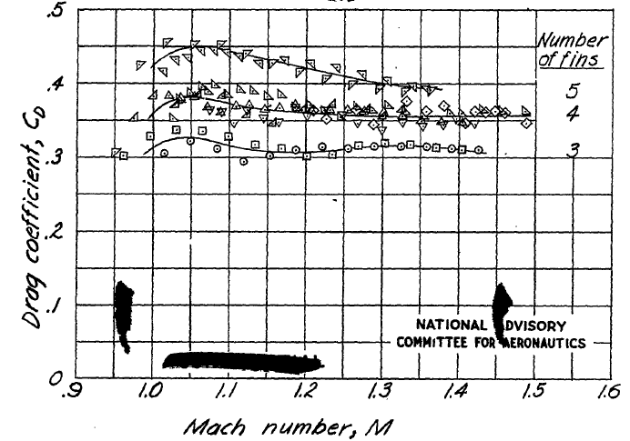
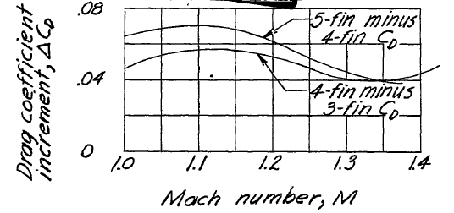
Fin Count¹¹
Fin Count > 3
  Skin Friction Drag Increases
  Interference Drag Increases up to Mach 1.35
Fin Count → 3
but not always …
Copyright © 2011 by Off We Go Rocketry

Slide 23
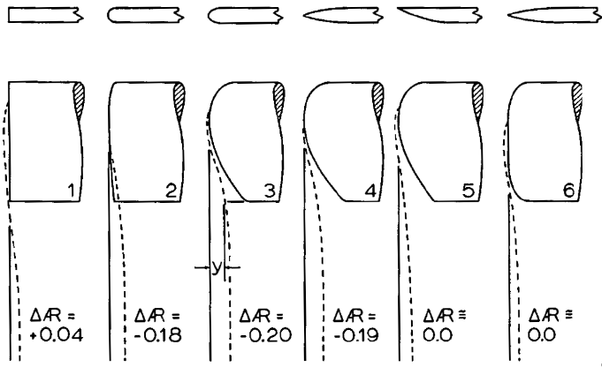
Fin Tip Vortices¹
Preferred
Desired
Vortices alter Fin Effective Aspect Ratio
Positive or Neutral Ratio Desired
  Lower Angles of Attack for Given Lift (Increases Corrective and Damping Moments)
  Lower Induced Drag for Given Lift
Desire Zero or Positive Effective Aspect Ratio
Ease of Manufacture
  Implies Fins with a Tip Cord > 0
  Square Edge Tips
Copyright © 2011 by Off We Go Rocketry

Slide 24

Fin Flutter²⁰
NASA Safety Factors
  15% between vehicle & flutter velocity
  32% between vehicle and flutter dynamic pressure
Copyright © 2011 by Off We Go Rocketry

Slide 25
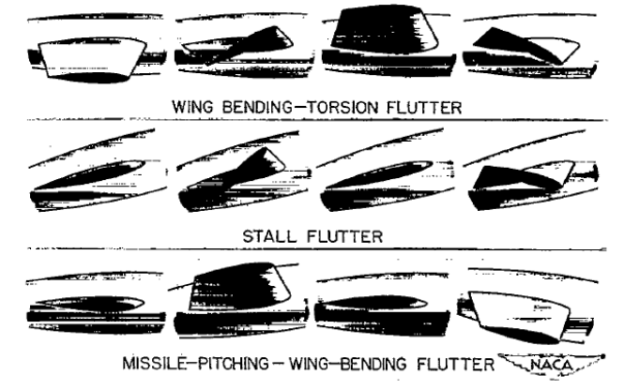
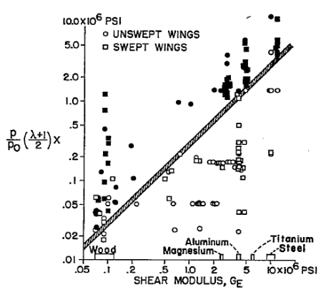
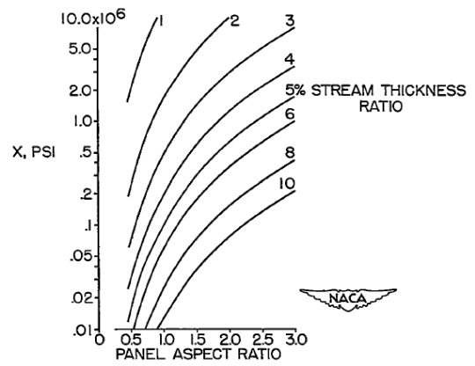
Fin Flutter¹⁶
Stall Flutter not applicable
Choose Shear Modulus for Material
Apply Contingency when selecting Flutter criterion
Criterion then used with Aspect Ratio to find Thickness Ratio
Multiple Thickness Ratio & Cord to get Thickness
Copyright © 2011 by Off We Go Rocketry

Slide 26
Fin Joint Drag^{1,12}
Interference Drag
    Minimized when fillet radius is between 4% and 8% of fin root cord
    10” Root Cord → ¹/₂” Radius
    Consider Structural Strength
Wing (Leading Edge) Fillets Increase Drag in the Transonic Region
Copyright © 2011 by Off We Go Rocketry

Slide 27
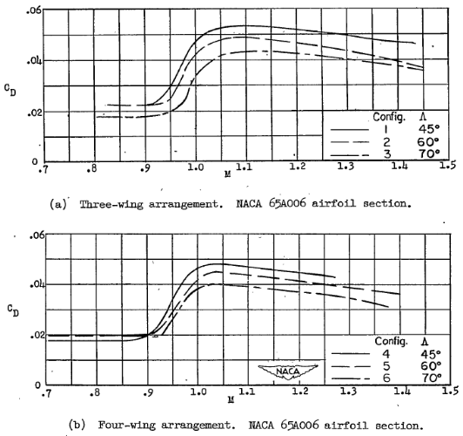
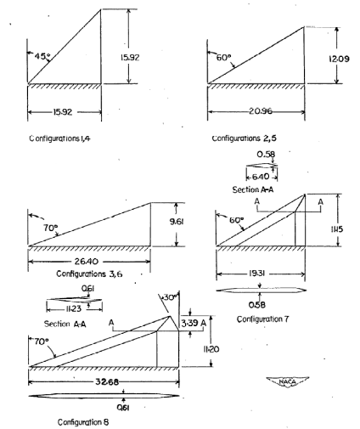
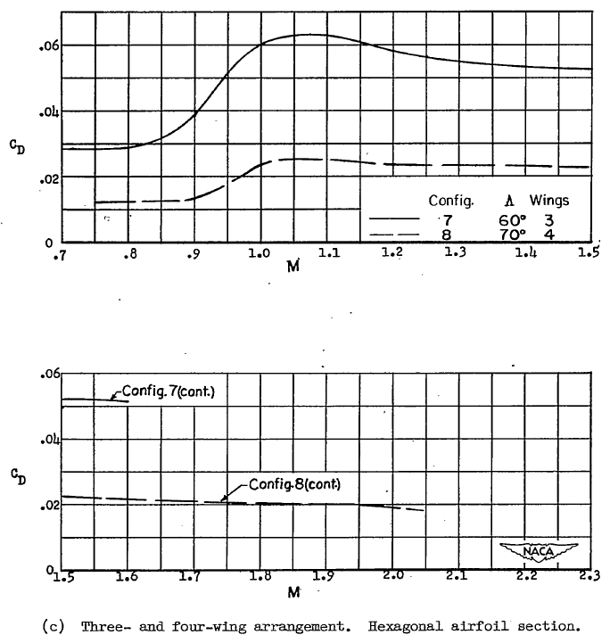
Sweep Angle¹³
70° Sweep Angle Superior to Smaller Angles in Sub, Trans, & Supersonic Ranges
  4 Fin Configuration Exception in Subsonic Region
Copyright © 2011 by Off We Go Rocketry

Slide 28
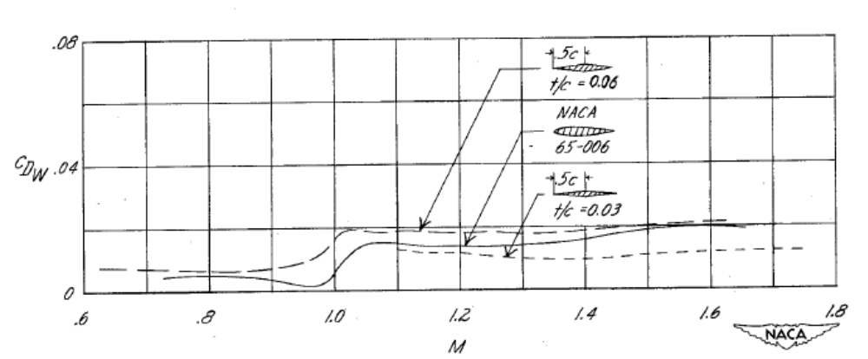
Fin Thickness^{15,17,18}
Thinner Symmetrical Fins Result in Lower C_{D} in Sub, Trans, and Supersonic Regions
Copyright © 2011 by Off We Go Rocketry

Slide 29
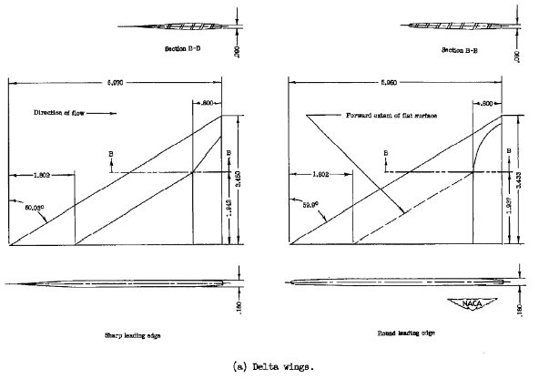
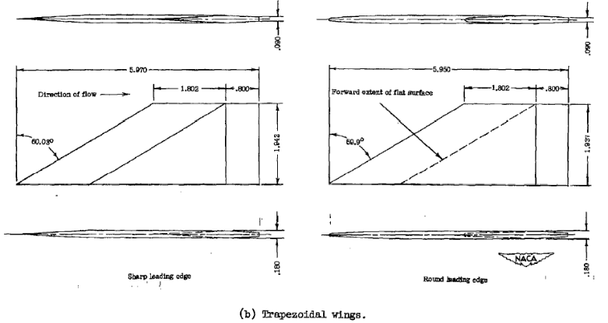
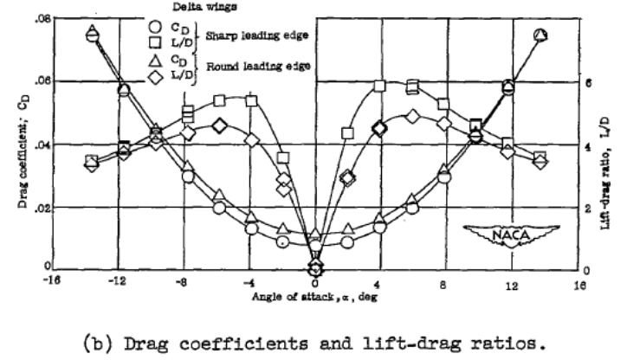
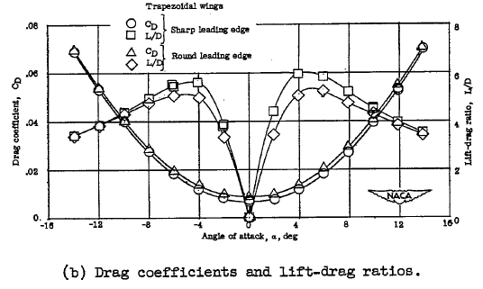
Leading Edge¹⁴
Copyright © 2011 by Off We Go Rocketry

Slide 30
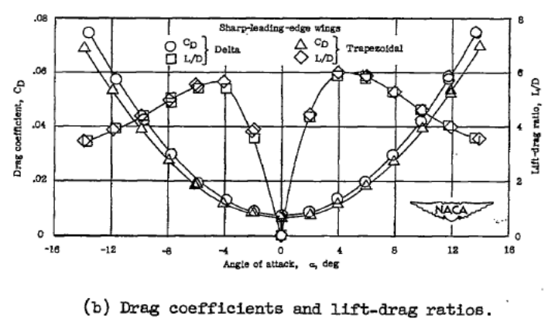
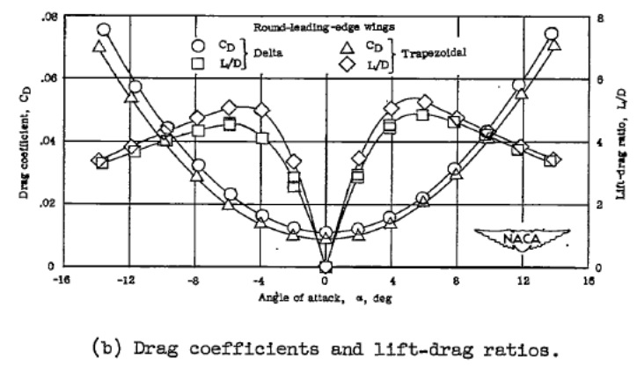
Leading Edge¹⁴
At Mach 4
  Sharp Leading Edge has Lower C_{D} at all Angles of Attack
  Trapezoidal (Clipped Delta) has Lower C_{D} than Delta
Copyright © 2011 by Off We Go Rocketry

Slide 31
Trailing Edge²¹
Trailing-edge Thickness up to 0.7% Root Cord Reduces Transonic Drag
  Does not Impact Subsonic Drag
Trailing Edge Thickness > 0.7% Results in Increased Drag
Varies with Airfoil Thickness and Optimum is < 0.7%
  10” Root Cord → ¹/₁₆” Thick Trailing Edge
Copyright © 2011 by Off We Go Rocketry

Slide 32
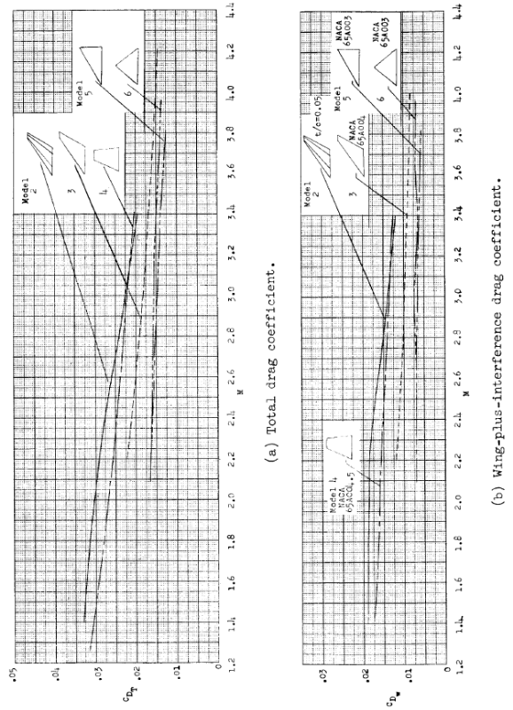
Fin Cross Section^{13,19}
Sub, Trans, and Supersonic
  Hexagonal Lower C_{D} than Double Wedge
Supersonic
  C_{D} NACA 65A003 < 65A004 < Hexagonal
Copyright © 2011 by Off We Go Rocketry

Slide 33
Shape^{14,19}
Supersonic Data
  Trapezoidal (Clipped Delta) Lower C_{D} than Delta
  Delta and Diamond have Similar C_{D}
Copyright © 2011 by Off We Go Rocketry

Slide 34
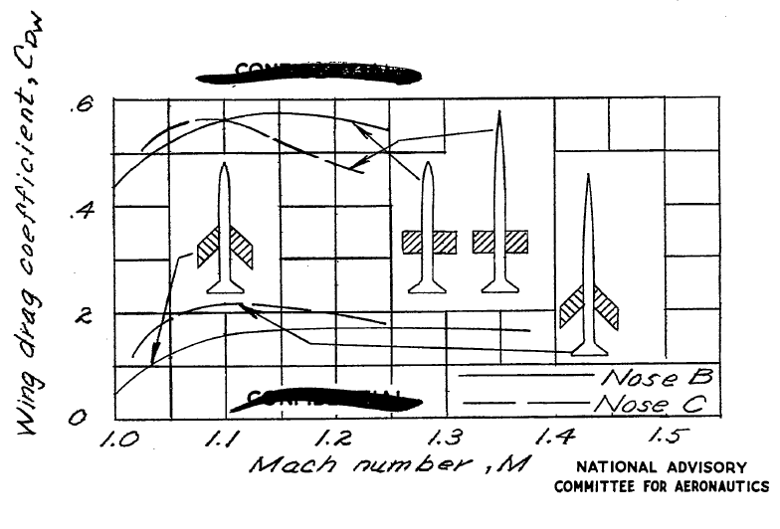
Multi-Disciplinary Design Optimization (MDO)^{x}
Optimizing Individual Components may not Result in an Optimum Design
  Increasing Fin count from 3 to 4
  Improving Nose Cone Fineness Ratio (3.5 vs. 7) may Result in Increased Fin Drag at Some Velocities
Copyright © 2011 by Off We Go Rocketry

Slide 35
Summary
Optimal Nose Cones
  Subsonic – Elliptical
  Transonic – Von Karman (Blunted 15% of Base Diameter)
  Supersonic - X^{¾} Power Series
  Hypersonic – X^{.6} Power Series
  Fineness Ratio of 5
Fin Optimization
  Fin Count of 3
  Fin Joints 4% to 8% of Root Cord
  Thickness < 10% of Root Cord often between 3% & 6%
  Trailing Edge Flat but < 0.7% of Root Cord in Thickness
  Leading Edge may be Sharp
  Sweep Angle between 45° and 70°
  Flat Fin Tips
  Hexagonal Cross Section
  Clipped Delta Shape
Copyright © 2011 by Off We Go Rocketry
Notes:
Copyright © 2010 by Gary Stroick
Where should the CP be in relation to the CG?
In front:
Torque generated by drag and lift will push the nose further off of the flight path!
Equal:
No torque will be generated by drag or lift forces.
No corrective aerodynamic forces!
Behind:
Torque generated by drag and lift will push the tail back on flight path!
Further back from CG the greater the corrective moment (increased sensitivity). Too far behind CG will result in overcorrection.

Slide 36
Appendices
Nose Cones

Slide 37
Nose Cone Geometries
Conical
Elliptical
Ogive (Tangent)
Parabolic
Power Series
Sears-Haack (Von Karman)
Copyright © 2011 by Off We Go Rocketry

Slide 38
Nose Cone Parameters
C_{L}
y
R
L
x
x = 0
x = L
y = 0
Dimensions used in the equations
y = R
L is the overall length of the nosecone
R is the radius of the base of the nosecone
y is the radius at any point x, as x varies from 0 at the tip of the nosecone to L
The full body of revolution of the nosecone is formed by rotating the profile around the centerline (C_{L})
Copyright © 2011 by Off We Go Rocketry

Slide 39

Conical Nose Cones
φ
C_{L}
R
L
The sides of a cone are straight lines, so the diameter equation is simply, y = ^{Rx}/_{L}
Cones are sometimes defined by their ‘half angle’, φ = tan⁻¹(^{R}/_{L}) and y = x tan φ
C_{p}=^{L}/₃
V=πR²L/3
S= πR(R² + L²)^{.5}
Copyright © 2011 by Off We Go Rocketry

Slide 40
Elliptical Nose Cones
C_{L}
R
L
The profile of this shape is one-half of an ellipse, with the major axis being the centerline and the minor axis being the base of the nosecone
This shape is advantageous for subsonic flight due to its blunt nose and tangent base
It is defined by: y = R(1-^{x2}/_{L}2)^{½}
C_{p}=^{3L}/₂
V=2πR²L/3
S=πL²+[πR²/σ[ln{(1+σ)/(1-σ)}]]/2 where σ=(L²+R²)/L
Copyright © 2011 by Off We Go Rocketry

Slide 41
Tangent Ogive Nose Cones
R
C_{L}
L
Ogive Radius
ρ
This shape is formed by a circle segment where the base is on the circle radius and the airframe is tangent to the curve of the nosecone at its base
The radius of the circle that forms the ogive is: ρ = (R² + L²)/2R
The radius y at any point x, as x varies from 0 to L is: y = (ρ²-(x-L)²)^{½}+R- ρ where L≤ρ
C_{p}=V/πR²
V=π[Lσ² - L³/σ – (σ³ - Rσ²)sin⁻¹(L/σ)] where σ=(R² + L²)/2R
S=?
Copyright © 2011 by Off We Go Rocketry

Slide 42
Parabolic Nose Cones
R
C_{L}
L
Full Parabola K=1
Axis of Symmetry
The Parabolic Series nose shape is generated by rotating a segment of a parabola around a line parallel to its axis of symmetry.
y=R{(2[^{x}/_{L}]-K[^{x}/_{L}]²)/(2-K)} for 0≤K≤1
  K= 0 for a CONE
  K= .5 for a 1/2 PARABOLA
  K= .75 for a 3/4 PARABOLA
  K= 1 for a PARABOLA (base tangent to airframe)
C_{p}=^{L}/₂
V= πR²L/2
S=R²/4L
Copyright © 2011 by Off We Go Rocketry

Slide 43
Power Series Nose Cones
C_{L}
R
L
Power Series
The Power Series shape is characterized by its (usually) blunt tip, and by the fact that its base is not tangent to the body tube.
The Power series nose shape is generated by rotating a parabola about its major axis. The base of the nosecone is parallel to the latus rectum of the parabola, and the factor n controls the ‘bluntness’ of the shape. As n decreases towards zero, the Power Series nose shape becomes increasingly blunt; at values of n above about .7, the tip becomes sharp.
y=R(^{x}/_{L})^{n} for 0≤n≤1
  n = 1 for a CONE
  n = .75 for a ¾ POWER
  n = .5 for a ½ POWER (PARABOLA)
  n = 0 for a CYLINDER
C_{p}=?
V=?
S=?
Copyright © 2011 by Off We Go Rocketry

Slide 44
Sears-Haack Nose Cones
C_{L}
R
L
Sears-Haack
Not constructed from geometric figures
Mathematically derived for drag minimization
Not tangent to body at base
Rounded not sharp nose tips
y = R{θ-[sin(2θ)/2]+Csin³(θ)}^{1/2}/(π)^{1/2} where 0≤C and θ = cos⁻¹(1-2x/L)
  C = 0 minimum drag for given Length and Volume (LV)
  C = 1/3 minimum drag for given Length and Diameter (LD - Von Karman)
C_{p}=^{L}/₂ Von Karman; C_{p}= .437L LV-Haack
V=?
S=?
Copyright © 2011 by Off We Go Rocketry

Slide 45
Nose Cone References
Topics in Advanced Model Rocketry; Mandell, Gordon K.; Caporaso, George J.; Bengen, William P.; The MIT Press; 1973
Investigation of the Drag of Various Axially Symmetric Nose Shapes of Fineness Ratio 3 for Mach Numbers from 1.24 to 3.67; Perkins, Edward W.; Jorgensen, Leland H.; NACA Research Memorandum A52H28; 1952.
Investigation of the Drag of Various Axially Symmetric Nose Shapes of Fineness Ratio 3 for Mach Numbers from 1.24 to 7.4; Perkins, Edward W.; Jorgensen, Leland H.; Sommer, Simon C.; NACA Technical Report 1386; 1958.
Transonic Drag Measurements of Eight-Body Nose Shapes; Stoney, Jr., William, G.; NACA Research Memorandum L53K17; 1954.
The Effect of Bluntness on the Drag of Spherical-Tipped Truncated Cones of Fineness Ratio 3 at Mach Numbers 1.2 to 7.4; Sommer, Simon C.; Stark, James A.; NACA Research Memorandum A52B13; 1954.
Pressure Drag of Bodies at Mach Numbers up to 2.0; Nelson, Robert L.; Stoney, Jr., William, G.; NACA Research Memorandum L53I22c; 1953.
Bodies of Revolution having Minimum Drag at High Supersonic Airspeeds; Eggers Jr, A. J.; Resnikoff, Meyer M.; Dennis, David H.; NACA Technical Report 1306, 1957.
Hypersonic Aerodynamic Performance of Minimum-Wave-Drag Bodies; Spencer, Jr., Bernard; Fox Jr., Charles H.; NASA Technical Report R-250; 1966.
Longitudinal Aerodynamic Performance of a Series of Power-Law and Minimum-Wave-Drag Bodies at Mach 6 and Several Reynolds Numbers; Ashby Jr., George C.; NASA Technical Memorandum X-2713; 1974.
Performance and Dynamics of Aerospace Vehicles; Love, E. S.; NASA SP-258; 1971; pages 103-174.
Copyright © 2011 by Off We Go Rocketry

Slide 46
Fin References
Effect of Number of Fins on the Drag of a Pointed Body of Revolution at Low Supersonic Velocities; Mastrocola, N; NACA Research Memorandum L7A08; 1947.
Transonic Drag Characteristics of a Wing-Body Combination Showing the Effect of a Large Wing Fillet; Cheatham, Donald C.; Kurbjun, Max C.; NACA Research Memorandum L8F08; 1948.
Damping in Roll of Models with 45°, 60°, and 70° Delta Wings Determined at High Subsonic, Transonic, and Supersonic Speeds with Rocket-Powered Models; Saunders Jr, E Claude; NACA Research Memorandum L52D22a; 1952.
Aerodynamic Characteristics of Two Delta Wings and Two Trapezoidal Wings at Mach 4.04; Dunning, Robert W.; Smith, Fred W.; NACA Research Memorandum L53D30A; 1953.
Results of a Flight Investigation to Determine the Zero-Lift Drag Characteristics of a 60° Delta Wing with NACA 65-006 Airfoil Section and Various Double-Wedge Sections at Mach Numbers from 0.7 to 1.6; Welsh, Clement J.; NACA Technical Note 3650; 1956.
Summary of Flutter Experiences as a Guide to the Preliminary Design of Lifting Surfaces on Missiles; Martin, Dennis J.; NACA Technical Note 4197; 1958.
The Characteristics of 78 Related Airfoil Sections from Tests in the Variable-Density Wind Tunnel; Jacobs, Eastman N.; Ward, Kenneth E.; Pinkerton, Robert N; NACA Technical Report 460; 1948.
Tests of 16 Related Airfoils at High Speeds; Stack, John; Von Doenhoff, Albert E.; NACA Technical Report 492; 1935.
Free-Flight Measurements of the Zero-Lift Drag of Several Wings at Mach Numbers from 1.4 to 3.8; Jackson, H. Herbert; NASA Technical Note D-395; 1960.
Aeroelastic Optimization of Sounding Rocket Fins; Simmons III, Joseph R.; Air Force Institute of Technology; 2009.
NASA Supercritical Airfoils; Harris, Charles D.; NASA Technical Paper 2969; 1990.
Copyright © 2011 by Off We Go Rocketry

Slide 47
MDO References
Results of Flight Tests at Supersonic Speeds to Determine the Effect of Body Nose Fineness Ratio on Body and Wing Drag; Katz, Ellis R; NACA Research Memorandum L7B19; 1947.
Copyright © 2011 by Off We Go Rocketry

Slide 48
Selected Websites
http://exploration.grc.nasa.gov/education/rocket/guided.htm
http://ntrs.nasa.gov/search.jsp
http://www.apogeerockets.com/Peak-of-Flight_index.asp
http://www.rocketmaterials.org/
http://www.aerorocket.com/
Copyright © 2011 by Off We Go Rocketry

